Slide 1
Currency exchange rate prediction(TR.6)
Team Name:
Speech Alchemy
Team Members:
Aditi Sant,Gargee Dorle,Maitreyee Patil,Mrunal Vibhute,Shreya Mote

Slide 2






Slide 3

Team Photograph

Slide 4
PROBLEM STATEMENT
Problem Statement :
Create a software program which predicts USD to INR rate for next day by considering the past data. You can take input data for last three years 2020 , 2021 and first six months of 2022 for training the model. You should use data of last six months of 2022 for prediction.
The basic data you will need is daily currency rates of USD to INR.
Other data you can use ( not mandatory ) to improve the accuracy can be divided in boradly three categories New article Analysis
Sentiment Analysis ( of tweets on twitter )
Factual data like yield, gdp, currency reserves .

Slide 5
INTRODUCTION/MOTIVE:
Currency exchange plays a vital role in the economy of any country. With trade relations between India and U.S.A closer than ever it becomes crucial to keep an eye on the ever changing rates of U.S.D. (U.S Dollar) and I.N.R(Indian National Rupee)
INR is always expressed in terms of another currency.
Normally, the most common benchmark is the US Dollar. Any weakening or strengthening of the dollar has a proportionate effect on the INR/USD exchange rate.

Slide 6
OUR PROPOSED APPROACH:
Our though thought flow progressed from using regression primarily.
In statistical analysis, regression is used to identify the associations between variables occurring in some data. It can show both the magnitude of such an association which is what required by our model.
Thus we approached the forest regression technique to proceed with the data.
Sentiment analysis using the latest tweets was used to improve the data accuracy. Linear regression was followed in that process

Slide 7
Why should you choose our solution?
The model uses a dataset and predicts the values of INR accordingly.
It can predicts the data for not only the further day but also for the next 2 years given the condition that the statistics remain the same.
Sentiment analysis classifies the positive , negative and neutral tweets which predicts the effects of tweets on the currency conversion rate.
We have used close to 2000 tweets for the survey.
Streamlit has been used as the front end which improves the user interface.

Slide 8
Limitations:
We have not used the official Library Tweepy so that might be the possible cause for minor deviations in the results.
However we are planning to overcome this limitation by merging the data from Official twitter APIs to increase the accuracy and correctness.

Slide 9
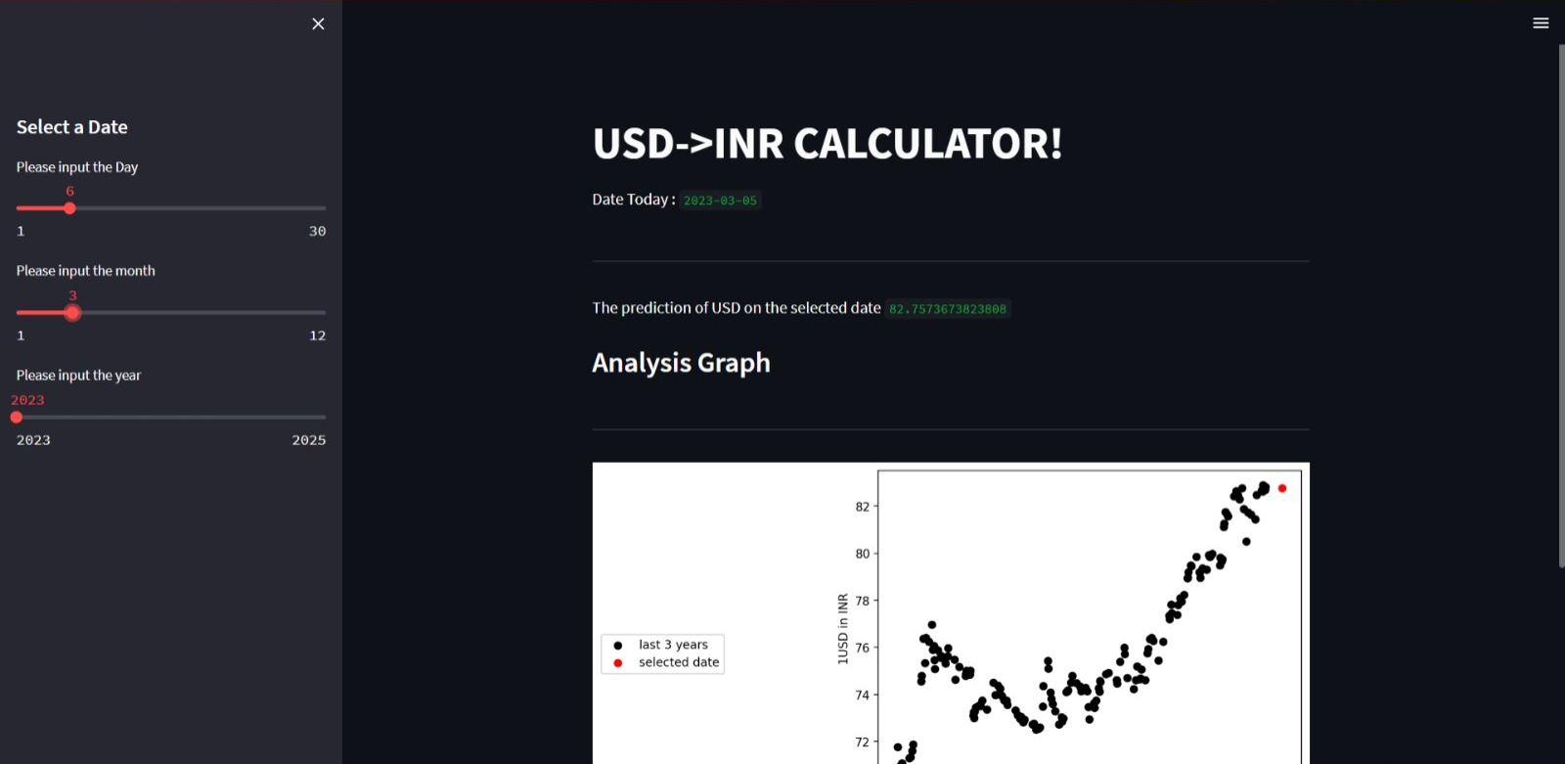
Screenshot :Output Prediction for 6th March

Slide 10
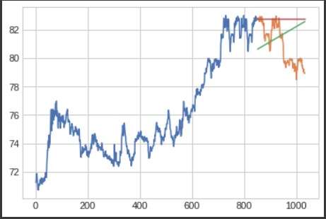
SCREENSHOTS-FOREST REGRESSION

Slide 11
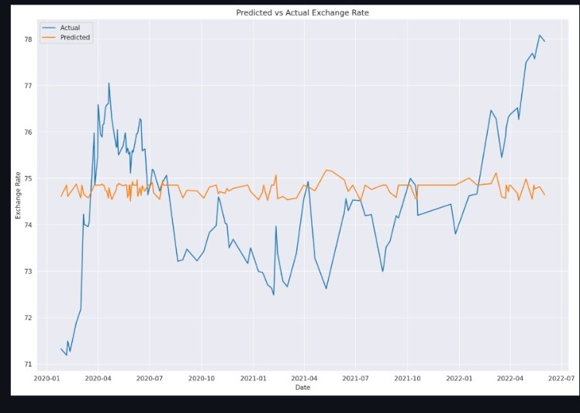
Screenshot:Sentiment Analysis Prediction

Slide 12
References
Streamlit documentation.
Scikit learn documentation .

